Slide 1
Second Quantization and
Ground State Energy Study
of Molecule H₂
Ting-Wei Chang
Wei-Chen Chien

Slide 2
Outline
Introduction
Structure of H₂ and parameters
2nd quantized Hamiltonian
PySCF
Qulacs
Results

Slide 3
Introduction
In this work, we study the ground state energy of molecule H₂ by generating second-quantized Hamiltonian from different packages ‘PySCF’ and ‘Qulacs’.
The 2nd-quantized Hamiltonians are then transformed into JW Hamiltonians by ‘openfermion’, and implemented by quantum circuits created by Qulacs.
The calculation results are compared along with traditional SCF results and FCI results.

Slide 4
Structure of H₂ and parameters
Structure of H₂
distance: 0.87 Å
basis: ‘sto-3g’
Quantum algorithms and ansatz
We choose VQE as our algorithms and create quantum circuits with hardware efficient ansatzes.

Slide 5
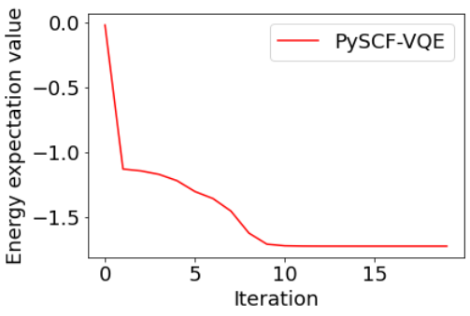
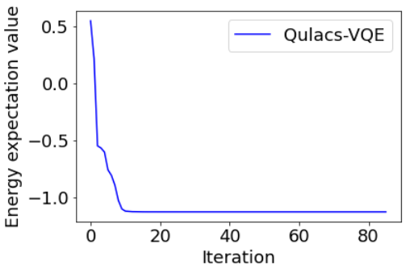
Second-quantized Hamiltonian
2nd-quantized Hamiltonian generated by PySCF
2 qubits are used in calculations
Ground state energy: -1.6820 (Hartree)
2nd-quantized Hamiltonian generated by Qulacs
4 qubits are used in calculations
Ground state energy: -1.1178 (Hartree)

Slide 6
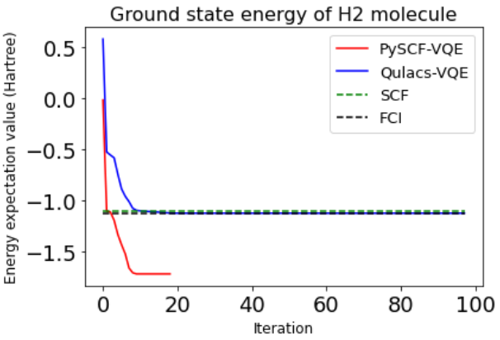
Results
Calculation method | Ground state energy (Hartree)
PySCF Hamiltonian | -1.6820
Qulacs Hamiltonian | -1.1178
Classical SCF | -1.0985
Classical FCI | -1.1254
The ground state energy from the ‘PySCF’ Hamiltonian is about 0.6 Hartree lower than other results.
There might be some parameters missing that leads to this difference.

